Slide 1

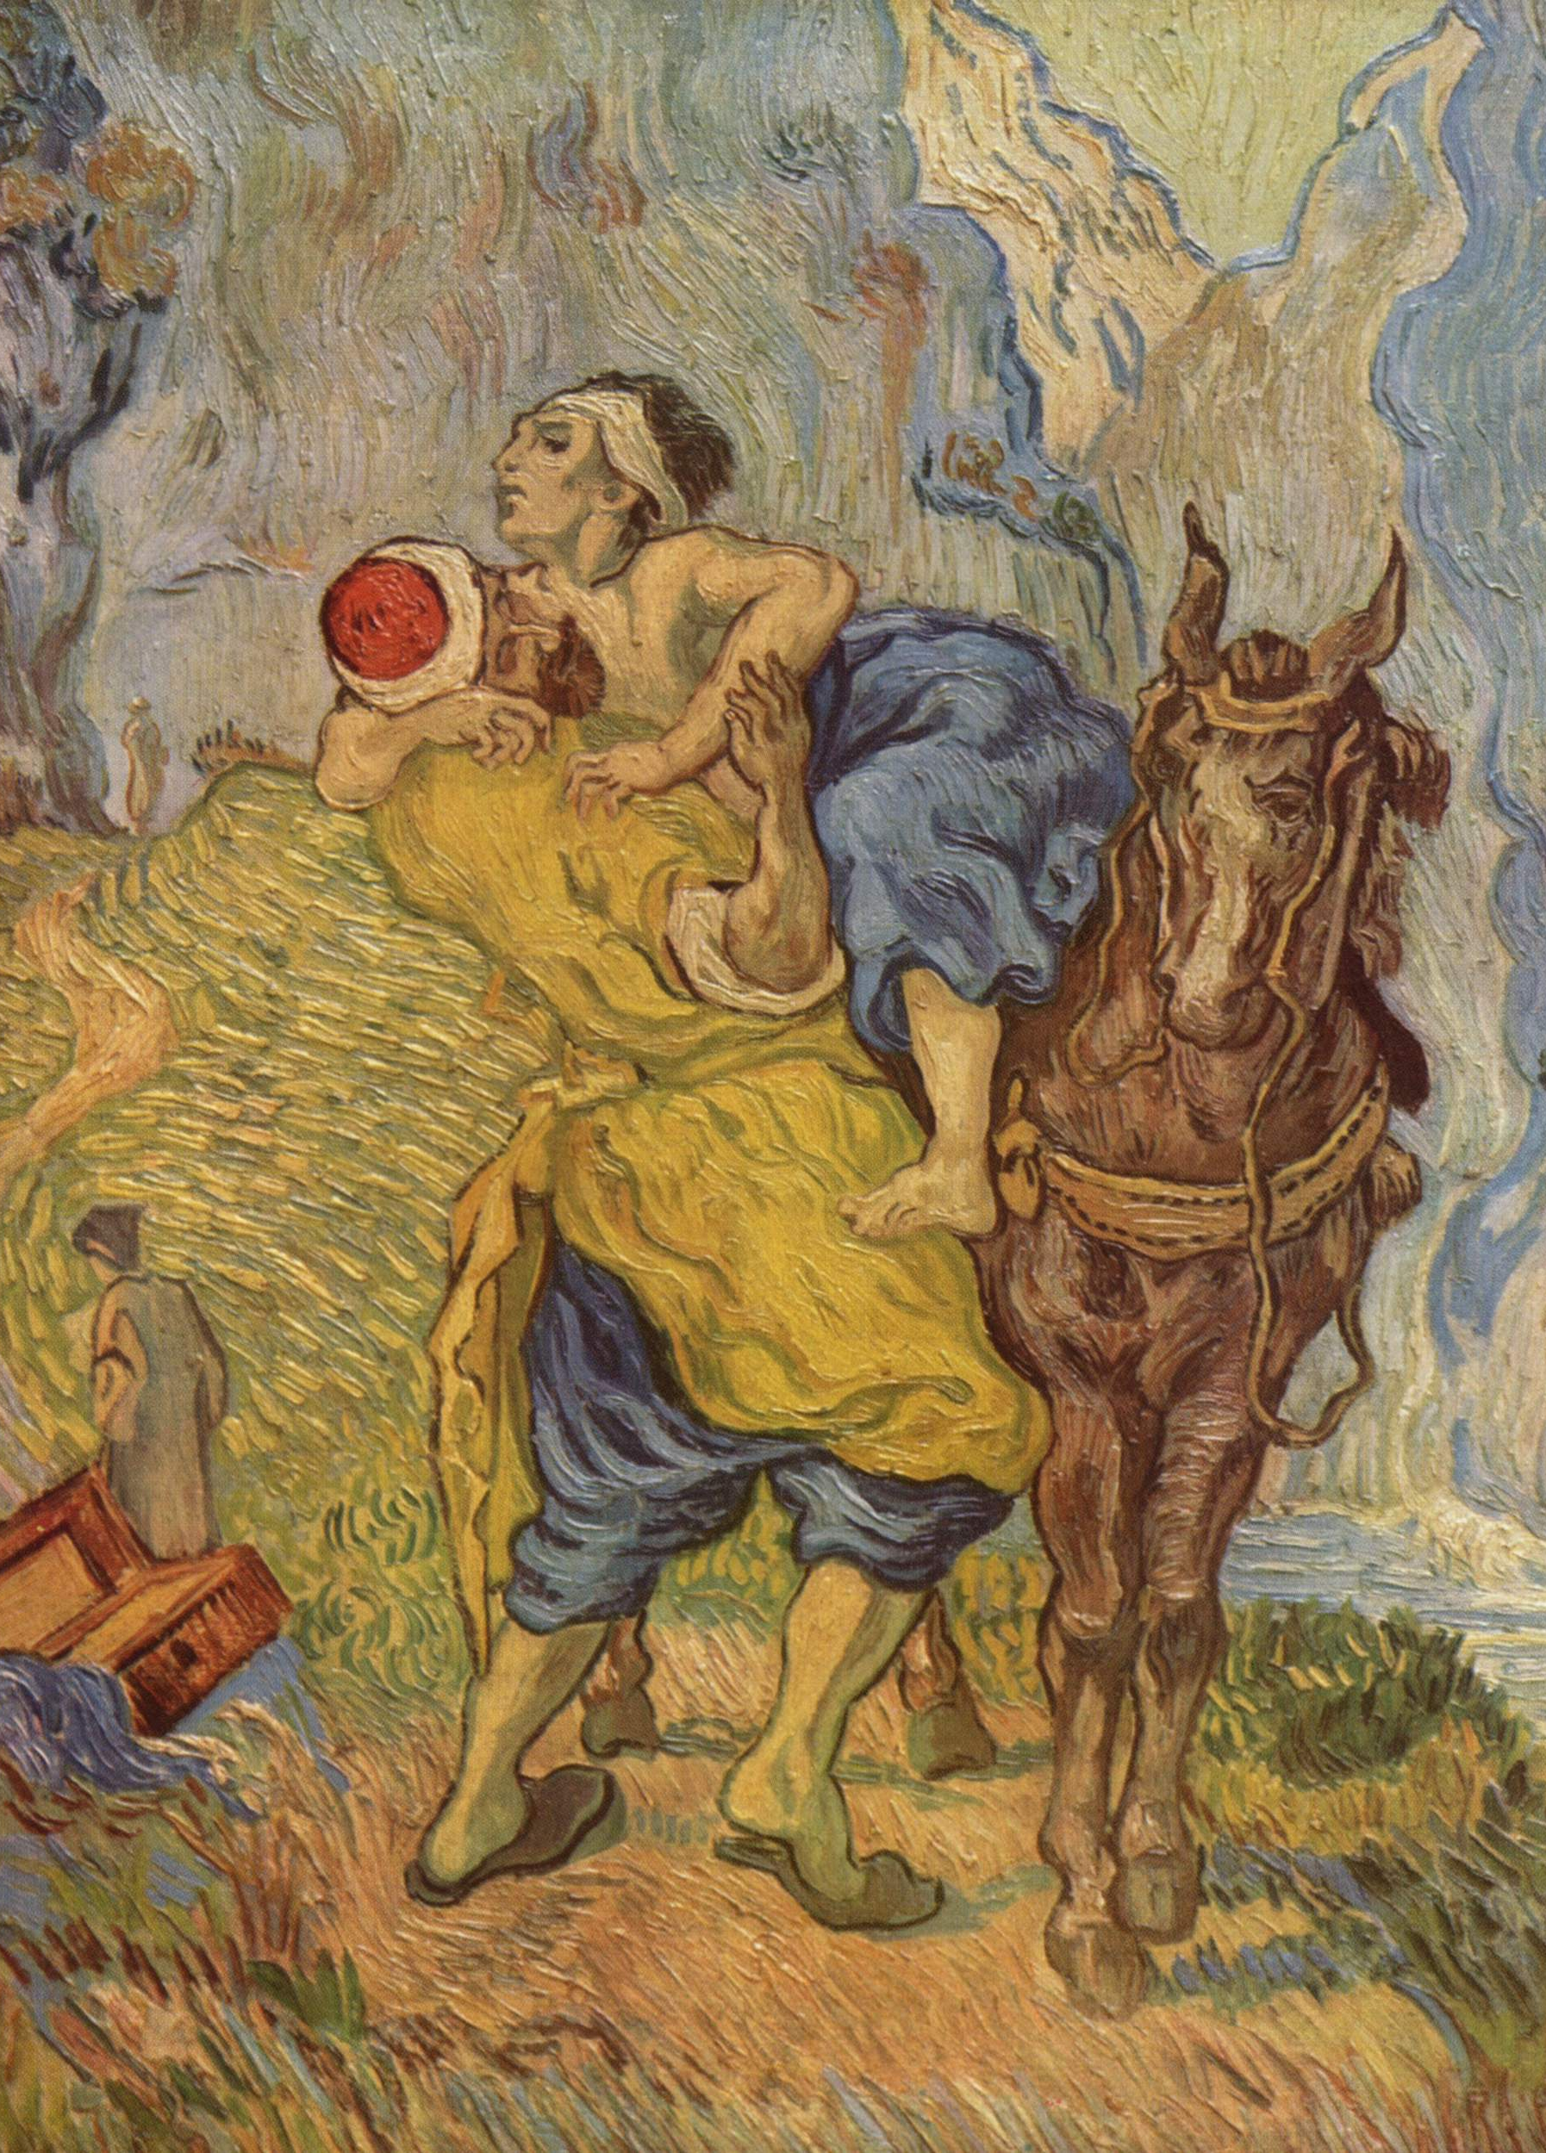
Duties to Strangers
PH1102E/GEK1067
Week 4

Slide 3
Moral philosophy asks two major questions:
(1) What is good for its own sake?
(2) What is the right thing to do in any situation?
According to some philosophers, there is a very close connection between these two questions.
These philosophers, known as “consequentialists,” say that the right thing to do in any situation is whatever will create the greatest net amount of that which is good for its own sake.
In other words, consequentialism is the view that the right thing to do in any situation is whatever will have the best consequences, in terms of the creation of absolute goodness or the elimination or avoidance of absolute badness.

Slide 4
Moral philosophy asks two major questions:
(1) What is good for its own sake?
(2) What is the right thing to do in any situation?
According to some philosophers, there is a very close connection between these two questions.
These philosophers, known as “consequentialists,” say that the right thing to do in any situation is whatever will create the greatest net amount of that which is good for its own sake.
In other words, consequentialism is the view that the right thing to do in any situation is whatever will have the best consequences, in terms of the creation of absolute goodness or the elimination or avoidance of absolute badness.

Slide 5
Moral philosophy asks two major questions:
(1) What is good for its own sake?
(2) What is the right thing to do in any situation?
According to some philosophers, there is a very close connection between these two questions.
These philosophers, known as “consequentialists,” say that the right thing to do in any situation is whatever will create the greatest net amount of that which is good for its own sake.
In other words, consequentialism is the view that the right thing to do in any situation is whatever will have the best consequences, in terms of the creation of absolute goodness or the elimination or avoidance of absolute badness.

Slide 6
Moral philosophy asks two major questions:
(1) What is good for its own sake?
(2) What is the right thing to do in any situation?
According to some philosophers, there is a very close connection between these two questions.
These philosophers, known as “consequentialists,” say that the right thing to do in any situation is whatever will create the greatest net amount of that which is good for its own sake.
In other words, consequentialism is the view that the right thing to do in any situation is whatever will have the best consequences, in terms of the creation of absolute goodness or the elimination or avoidance of absolute badness.

Slide 7
Moral philosophy asks two major questions:
(1) What is good for its own sake?
(2) What is the right thing to do in any situation?
According to some philosophers, there is a very close connection between these two questions.
These philosophers, known as “consequentialists,” say that the right thing to do in any situation is whatever will create the greatest net amount of that which is good for its own sake.
In other words, consequentialism is the view that the right thing to do in any situation is whatever will have the best consequences, in terms of the creation of absolute goodness or the elimination or avoidance of absolute badness.

Slide 8
In other words, consequentialism is the view that the right thing to do in any situation is whatever will have the best consequences, in terms of the creation of absolute goodness or the elimination or avoidance of absolute badness.

Slide 9
In other words, consequentialism is the view that the right thing to do in any situation is whatever will have the best consequences, in terms of the creation of absolute goodness or the elimination or avoidance of absolute badness.
Different consequentialist theories of right and wrong result from different conceptions of absolute value.
For example, a consequentialist who thinks that pleasure is the only thing that’s good for its own sake will say that the right thing to do in any situation is whatever maximizes the net amount of pleasure in the world.
A consequentialist who thinks that knowledge is the only thing that’s good for its own sake will say that the right thing to do is whatever maximizes the total amount of knowledge.

Slide 10
In other words, consequentialism is the view that the right thing to do in any situation is whatever will have the best consequences, in terms of the creation of absolute goodness or the elimination or avoidance of absolute badness.
Different consequentialist theories of right and wrong result from different conceptions of absolute value.
For example, a consequentialist who thinks that pleasure is the only thing that’s good for its own sake will say that the right thing to do in any situation is whatever maximizes the net amount of pleasure in the world.
A consequentialist who thinks that knowledge is the only thing that’s good for its own sake will say that the right thing to do is whatever maximizes the total amount of knowledge.

Slide 11
In other words, consequentialism is the view that the right thing to do in any situation is whatever will have the best consequences, in terms of the creation of absolute goodness or the elimination or avoidance of absolute badness.
Different consequentialist theories of right and wrong result from different conceptions of absolute value.
For example, a consequentialist who thinks that pleasure is the only thing that’s good for its own sake will say that the right thing to do in any situation is whatever maximizes the net amount of pleasure in the world.
A consequentialist who thinks that knowledge is the only thing that’s good for its own sake will say that the right thing to do is whatever maximizes the total amount of knowledge.

Slide 13
One important genre of consequentialism says that the right thing to do in any situation is whatever will have the best consequences for human welfare.
This kind of consequentialism is known as utilitarianism.
A common complaint against utilitarianism is that it sets an impossibly high moral standard.
For example, utilitarianism seems to require that members of first-world society should donate almost all of their income to global relief efforts aimed at improving the lot of the world’s poor.

Slide 14
One important genre of consequentialism says that the right thing to do in any situation is whatever will have the best consequences for human welfare.
This kind of consequentialism is known as utilitarianism.
A common complaint against utilitarianism is that it sets an impossibly high moral standard.
For example, utilitarianism seems to require that members of first-world society should donate almost all of their income to global relief efforts aimed at improving the lot of the world’s poor.

Slide 15
One important genre of consequentialism says that the right thing to do in any situation is whatever will have the best consequences for human welfare.
This kind of consequentialism is known as utilitarianism.
A common complaint against utilitarianism is that it sets an impossibly high moral standard.
For example, utilitarianism seems to require that members of first-world society should donate almost all of their income to global relief efforts aimed at improving the lot of the world’s poor.

Slide 17
Today we consider a counter-argument from the side of utilitarianism.
This argument aims to show that we do hold ourselves to the utilitarian standard whenever we pay careful attention to the consequences of our actions.
When we fail to live up to the utilitarian standard, it is only because we lose sight of these consequences (by choice or habit).

Slide 18
Today we consider a counter-argument from the side of utilitarianism.
This argument aims to show that we do hold ourselves to the utilitarian standard whenever we pay careful attention to the consequences of our actions.
When we fail to live up to the utilitarian standard, it is only because we lose sight of those consequences (by choice or habit).

Slide 20

Self & Community
Notes:
Wrong not to save him if it only costs you a dry-cleaning (or even the cost of a new suit).
We tend to think: wrong not to save him if doing so prevents you from claiming a $100,000 prize.
And even: if doing so prevents you from meeting a deadline with the result that you lose your job, your income, and your home.

Slide 21
Self & Community
Notes:
Wrong not to save him if it only costs you a dry-cleaning (or even the cost of a new suit).
We tend to think: wrong not to save him if doing so prevents you from claiming a $100,000 prize.
And even: if doing so prevents you from meeting a deadline with the result that you lose your job, your income, and your home.

Slide 22
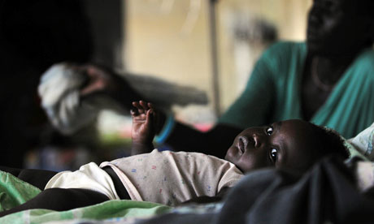
Self & Community
Notes:
This child is dying of malaria. (Actually, this child has already died of malaria. But there are thousands of similar children who are presently dying of malaria -- about 2,000 die of malaria every day, in Africa alone.)
It costs about $10 to cure a case of malaria.
So, if you were to donate $1,000 to a charity that fights malaria, you would save one child, even if 99% of your donation were absorbed by administrative costs.
Question: do you have a duty to make such a donation?

Slide 23
Self & Community
Notes:
This child is dying of malaria. (Actually, this child has already died of malaria. But there are thousands of similar children who are presently dying of malaria -- about 2,000 die of malaria every day, in Africa alone.)
It costs about $10 to cure a case of malaria.
So, if you were to donate $1,000 to a charity that fights malaria, you would save one child, even if 99% of your donation were absorbed by administrative costs.
Question: do you have a duty to make such a donation?

Slide 24

Peter Singer’s Argument
Your relationship to the drowning child does not differ in any morally relevant way from your relationship to the African child.
It would be morally wrong for you not to save the drowning child.
Therefore, it is wrong for you not to save the African child.
Peter Singer (1946- )

Slide 25
Objections to Premise 1

Slide 26
Your relationship to the drowning child does not differ in any morally relevant way from your relationship to the African child.

Slide 27
Your relationship to the drowning child does not differ in any morally relevant way from your relationship to the African child.
Your relationship to the drowning child does not differ in any morally relevant way from your relationship to the African child.
It would be morally wrong for you not to save the drowning child.
Therefore, it is wrong for you not to save the African child.
Peter Singer (1946- )

Slide 28
Your relationship to the drowning child does not differ in any morally relevant way from your relationship to the African child.

Slide 29
Your relationship to the drowning child does not differ in any morally relevant way from your relationship to the African child.
“The African children are far away; the drowning child is right in front of me.”

Slide 30

Travel time to major cities (in hours and days) and shipping lane density
Notes:
It’s no more difficult to save the African child than the child in the pond. In fact, it might be easier: you don’t even have to leave your computer.

Slide 31
Your relationship to the drowning child does not differ in any morally relevant way from your relationship to the African child.

Slide 32

Your relationship to the drowning child does not differ in any morally relevant way from your relationship to the African child.
“If I don’t jump into the pond, a specific child will die as a result. But no specific child will die as a result of my failing to donate.”
?

Slide 33
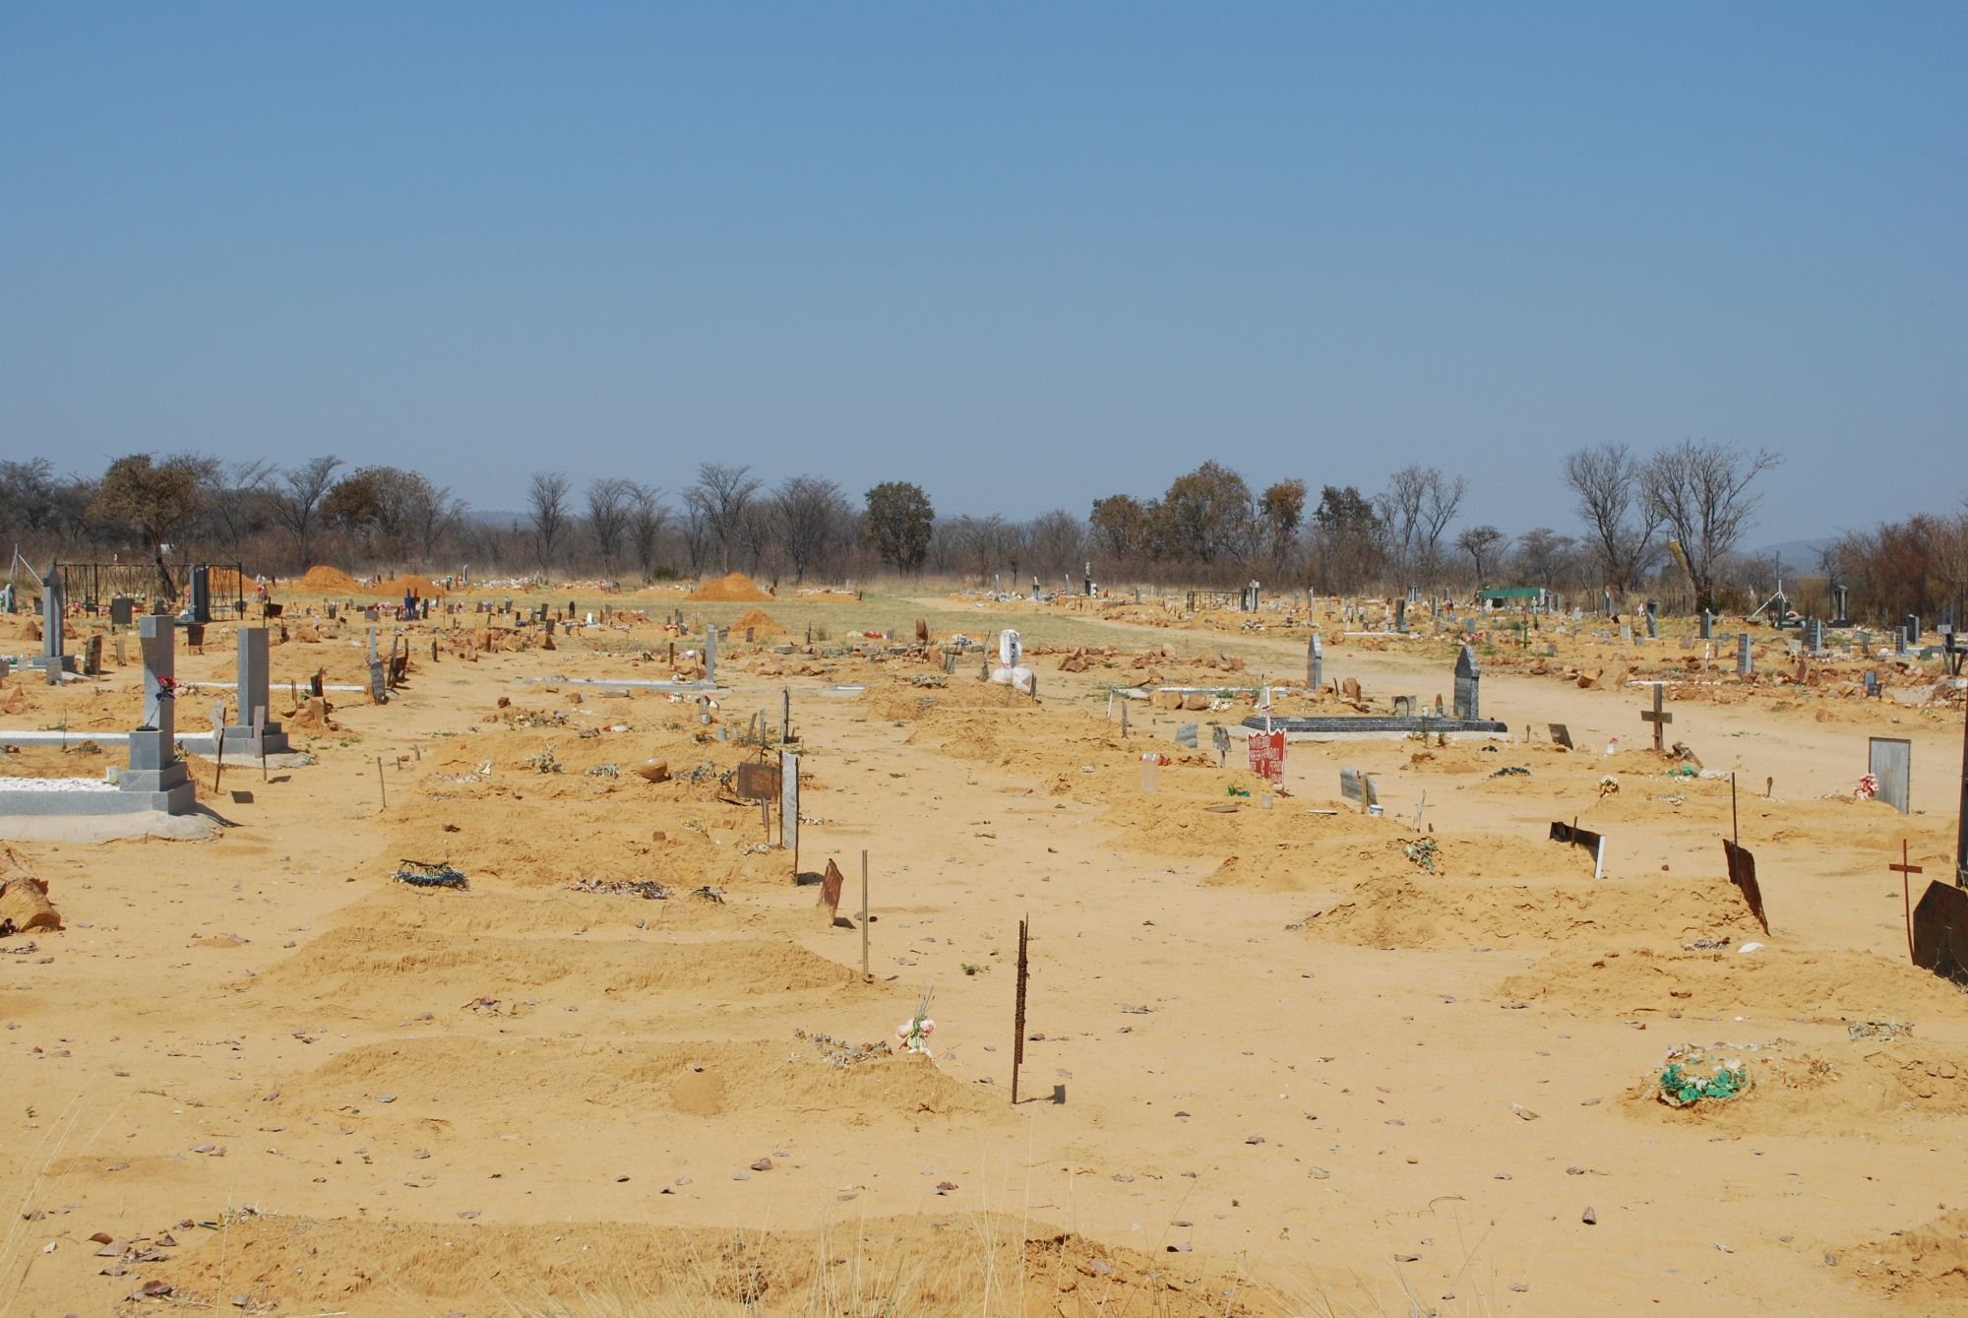

Slide 34
Your relationship to the drowning child does not differ in any morally relevant way from your relationship to the African child.

Slide 35
Your relationship to the drowning child does not differ in any morally relevant way from your relationship to the African child.
“Failing to jump into the pond would demonstrate a lack of compassion. Not so failing to donate to relief efforts.”

Slide 36
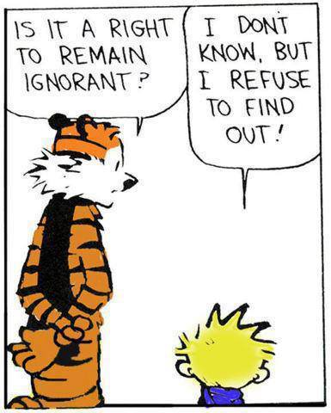
Notes:
But that can only be if you are ignorant of the Africans’ plight. But you are not (at least not now).
And who’s less virtuous of two non-donators: the one who bears the consequences of his failure to donate clearly in mind, or the one who banishes the consequences from his thoughts? (Two streets to the condo: Skid Row vs. Rolex Avenue.)

Slide 37
Your relationship to the drowning child does not differ in any morally relevant way from your relationship to the African child.

Slide 38
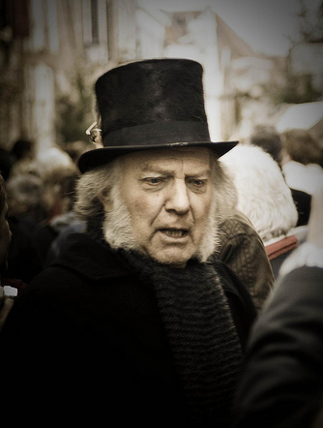
Your relationship to the drowning child does not differ in any morally relevant way from your relationship to the African child.
“Saving these wretched people now just creates more misery down the road.”
Ebenezer Scrooge

Slide 39
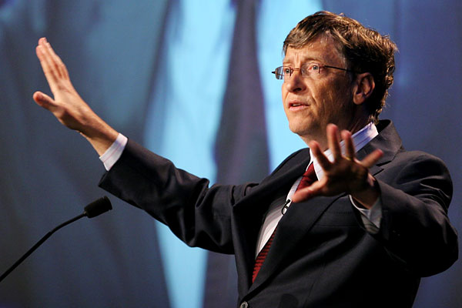

Slide 40
Your relationship to the drowning child does not differ in any morally relevant way from your relationship to the African child.
“Even if I donate everything I have, thousands of sick children will still die.”

Slide 41
Your relationship to the drowning child does not differ in any morally relevant way from your relationship to the African child.
“The drowning child is a problem I can solve. But even if I donate everything I have, thousands of sick children will still die.”

Slide 44
Your relationship to the drowning child does not differ in any morally relevant way from your relationship to the African child.

Slide 45
Your relationship to the drowning child does not differ in any morally relevant way from your relationship to the African child.
“Since many others are also in a position to help, my personal obligation to do so is small.”

Slide 49
Peter Singer’s Argument
Your relationship to the drowning child does not differ in any morally relevant way from your relationship to the African child.
It would be morally wrong for you not to save the drowning child.
Therefore, it is wrong for you not to save the African child.

Slide 50
Peter Singer’s Argument
❐
Your relationship to the drowning child does not differ in any morally relevant way from your relationship to the African child.
It would be morally wrong for you not to save the drowning child.
Therefore, it is wrong for you not to save the African child.

Slide 51
Objection to Premise 2

Slide 52
It would be wrong for you not to save the drowning child.

Slide 53
It would be wrong for you not to save the drowning child.
Your relationship to the drowning child does not differ in any morally relevant way from your relationship to the African child.
It would be morally wrong for you not to save the drowning child.
Therefore, it is wrong for you not to save the African child.
Peter Singer (1946- )

Slide 54
It would be wrong for you not to save the drowning child.

Slide 55
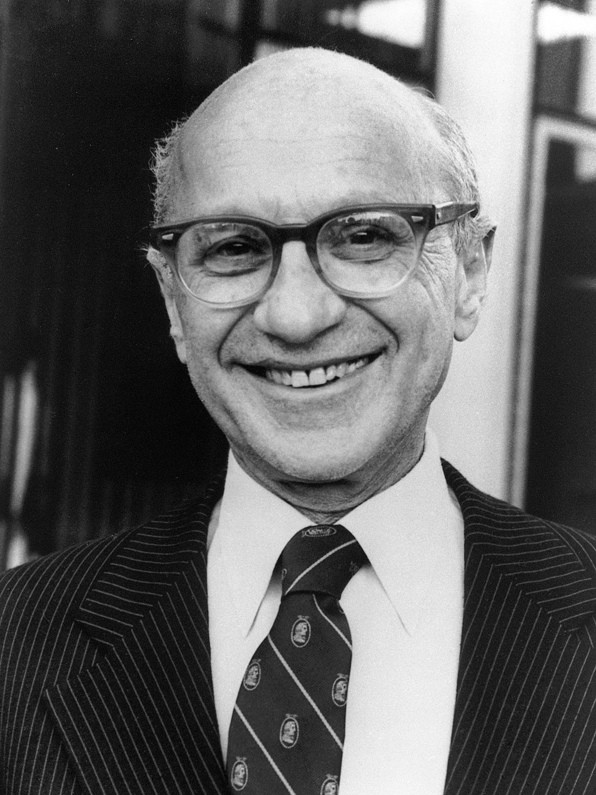
It would be wrong for you not to save the drowning child.
Milton Friedman (1912-2006)

Slide 56
It would be wrong for you not to save the drowning child.
That depends on how much it costs you to save the child, and how much the child’s life is worth.
Milton Friedman (1912-2006)

Slide 57
It would be wrong for you not to save the drowning child.
Singer

Slide 58
It would be wrong for you not to save the drowning child.
How can you put a price on a human life?
Singer

Slide 59
It would be wrong for you not to save the drowning child.
Friedman

Slide 60
It would be wrong for you not to save the drowning child.
We do it all the time.
A human life is not infinitely valuable.
If it were, there would be nothing wrong with sacrificing a million lives to save just one.
Friedman

Slide 61
It would be wrong for you not to save the drowning child.
We do it all the time.
A human life is not infinitely valuable.
If it were, there would be nothing wrong with sacrificing a million lives to save just one.
Friedman

Slide 62
It would be wrong for you not to save the drowning child.
So each human life has some finite value.
The question is: how do we determine that value?
Friedman
Notes:
People are generally unwilling to pay much for healthy food, safety features, etc. that stand to prolong their lives. This suggests that they put a low value on their lives. On the other hand, people in need of expensive medical treatment to stay alive often feel entitled to such treatment, regardless of the cost. This suggests that they put a very high value on their lives. Conclusion: people are bad at estimating the values of their own lives.

Slide 63
It would be wrong for you not to save the drowning child.
The best estimate of a life’s utilitarian value is given by lifetime income.
This is a rough measure of the net amount of utility (happiness or fulfillment) that the person generates over the course of his or her life.
Friedman
Notes:
This is how people figure out how much to pay for insurance (for themselves or others).
The connection between income and happiness generated is sometimes fairly transparent, in other cases not.

Slide 64
It would be wrong for you not to save the drowning child.
In impoverished countries, annual incomes average less that $1,000.
With improvements in life expectancy, this might translate into $40,000 lifetime income, accumu-lated over a sixty year period from birth.
Friedman

Slide 65
It would be wrong for you not to save the drowning child.
If I invest $700 today with a 7% annual return on my investment, I’ll have over $40,000 after 60 years.
So I should not, by utilitarian standards, be willing to spend more than $700 to save the African child.
Friedman
Notes:
Return on investment corresponds to creation of human happiness/fulfillment. That’s how you make money: by giving people goods and services that make them happy (or at least satisfy their desires).
For an average Singaporean child, the figure is about $41,000. (Invested at 7% return over 60 years, this gives about $2.4 million, which is the average lifetime earnings of a Singaporean.)

Slide 66
It would be wrong for you not to save the drowning child.
By the same token, if the child in the pond is worth the same as the child in Africa, a utilitarian should not be willing to incur more than $700 in dry-cleaning bills in an effort to save him or her from drowning.
Friedman

Slide 67
It would be wrong for you not to save the drowning child.
But according to our best available estimates, it takes a donation of more than $2,000 to save an impoverished life.
That is $1,300+ more than the life is worth, by utilitarian standards.
Friedman
Notes:
GiveWell reckons that a cost-per-life-saved of less than $3,000 is excellent, and estimates the CPLS of the Against Malaria Foundation (it’s #1 relief organization for cost effectiveness) at around $2,300. So my earlier suggestion that a $1,000 donation would be enough to save a life was over-optimistic.

Slide 68
It would be wrong for you not to save the drowning child.
Of course, if the drowning child is a citizen of Singapore (or some other wealthy country), its prospective lifetime income is much greater.
So a utilitarian should be willing to sacrifice more to save that child’s life.
Friedman

Slide 69
It would be wrong for you not to save the drowning child.
Singer

Slide 70
It would be wrong for you not to save the drowning child.
This is extremely distasteful.
Singer

Slide 71
It would be wrong for you not to save the drowning child.
Friedman

Slide 72
It would be wrong for you not to save the drowning child.
If my conclusions are distasteful, don’t blame me: blame Utilitarianism.
After all, lifetime income is a rough measure only of the utilitarian value of a life.
If a human life also has some non-utilitarian value, my argument collapses.
Friedman

Slide 73
conclusions

Slide 74
Utilitarians say that you have a moral obligation to maximize human welfare.
Utilitarianism therefore requires you to devote your excess income to humanitarian aid, assuming that the lives that such aid saves are worth more, in utilitarian terms, than anything else you might get for the same money.
Whether a needy child’s life does, in fact, have greater utilitarian value than some luxury depends on the utilitarian value of the particular child, which Singer does not establish.

Slide 75
Utilitarians say that you have a moral obligation to maximize human welfare.
Utilitarianism therefore requires you to devote your excess income to humanitarian aid, assuming that the lives that such aid saves are worth more, in utilitarian terms, than anything else you might get for the same money.
Whether a needy child’s life does, in fact, have greater utilitarian value than some luxury depends on the utilitarian value of the particular child, which Singer does not establish.

Slide 76
Utilitarians say that you have a moral obligation to maximize human welfare.
Utilitarianism therefore requires you to devote your excess income to humanitarian aid, assuming that the lives that such aid saves are worth more, in utilitarian terms, than anything else you might get for the same money.
Whether a needy child’s life does, in fact, have greater utilitarian value than some luxury depends on the utilitarian value of the particular child, which Singer does not establish.

Slide 77
Utilitarians say that you have a moral obligation to maximize human welfare.
Utilitarianism therefore requires you to devote your excess income to humanitarian aid, assuming that the lives that such aid saves are worth more, in utilitarian terms, than anything else you might get for the same money.
Whether a needy child’s life does, in fact, have greater utilitarian value than some luxury depends on the utilitarian value of the particular child, which Singer does not establish.

Slide 78
End of lecture.

Slide 79
Weekly Assignment #3
“The factory farming industry is so vast that there is nothing an individual consumer can do to influence it.” How would Alastair Norcross respond to this?
Limit: 200 words max.
Upload by 8:00pm, Thursday 11 September.

